Slide 1
FITSPOT
Train in peace

Slide 2
OUR APPLICATION
Nobody wants to work in crowded gyms.
That's why we developed FITSPOT.
Our app helps you find the optimal time to train

Slide 3


FITSPOT

Slide 4
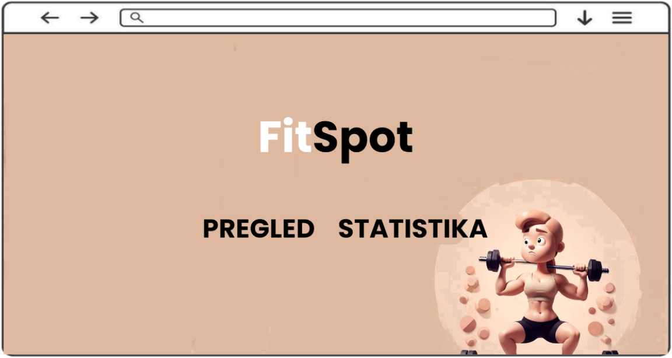

Slide 5
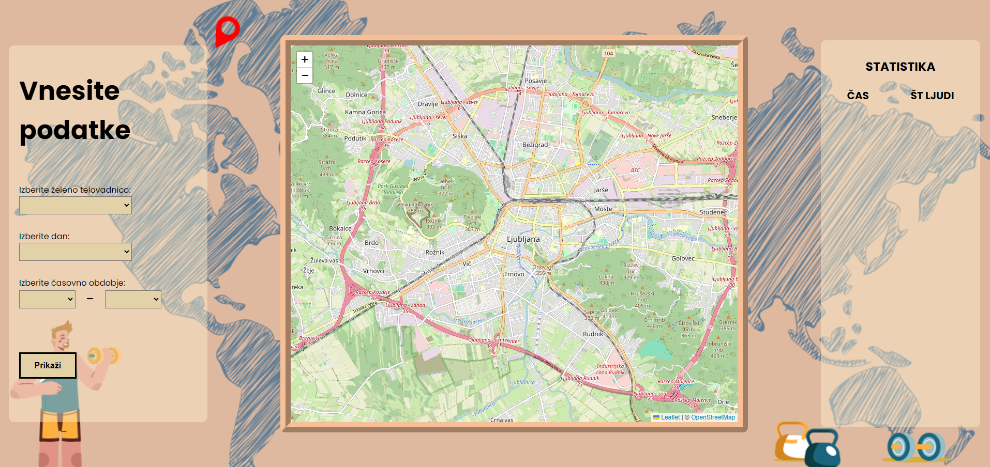

Slide 6
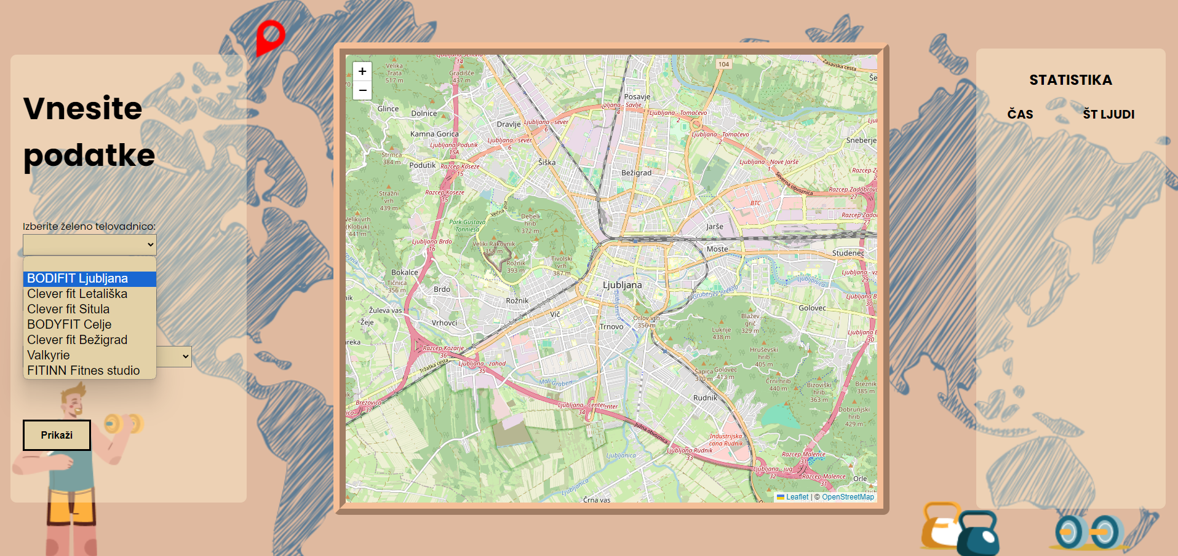

Slide 7
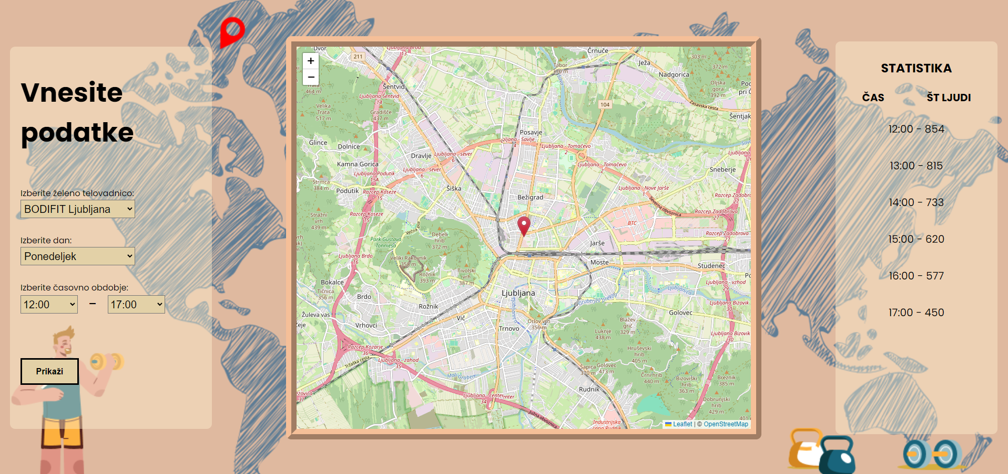

Slide 9
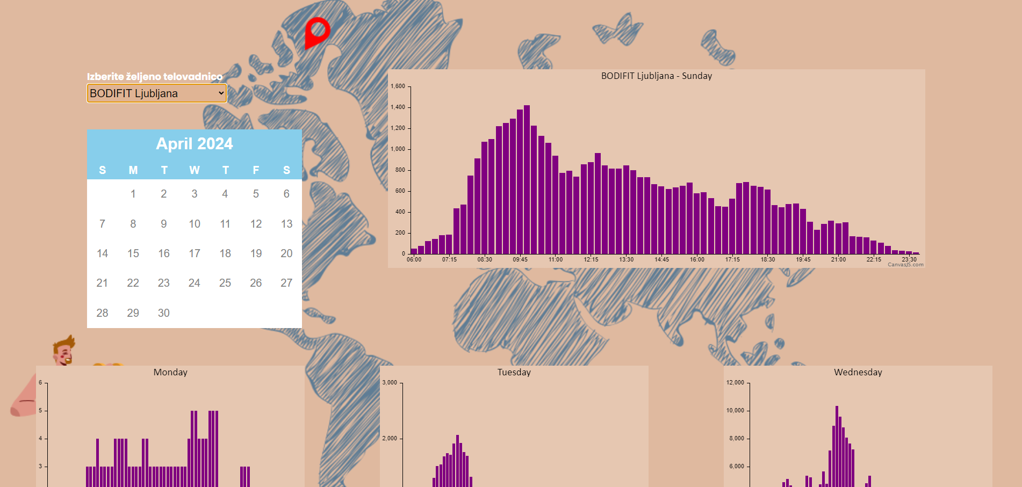

Slide 10
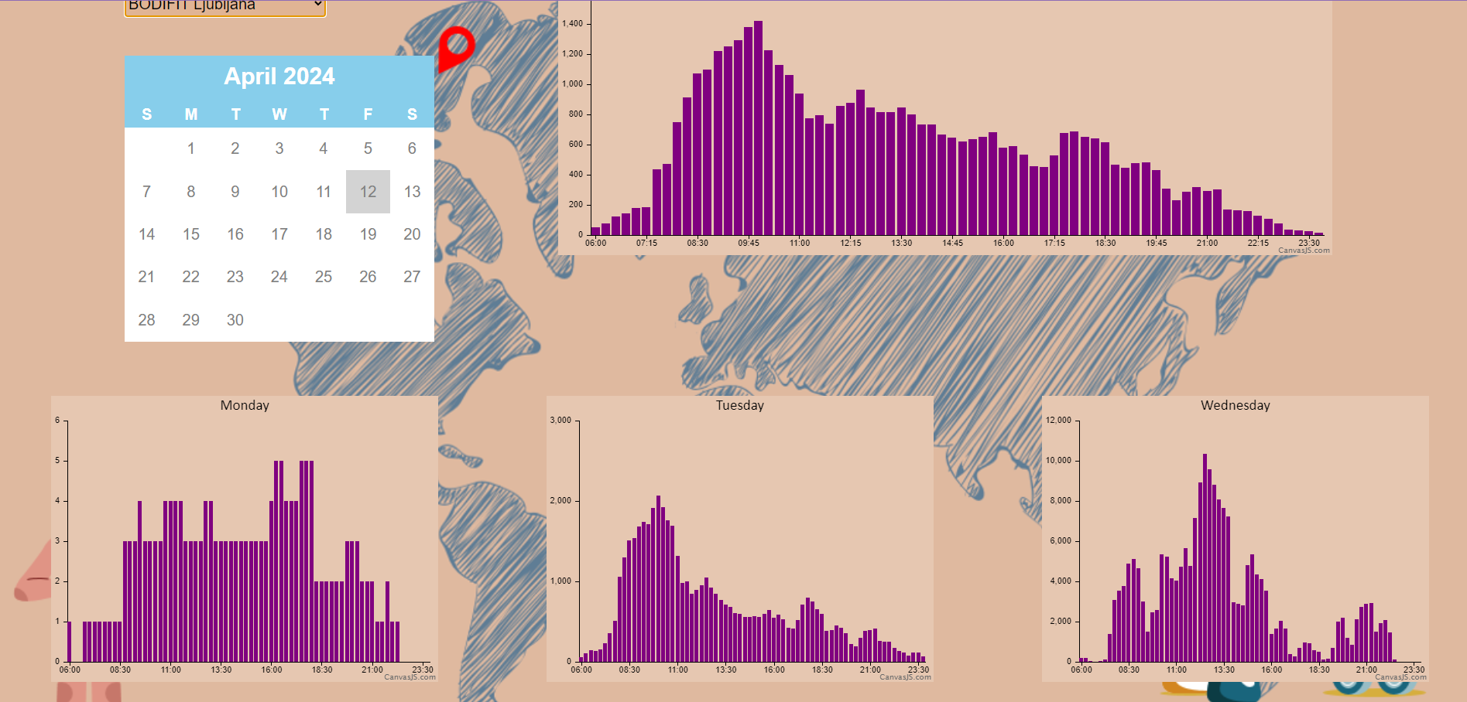

Slide 11


TRAINED MODEL
RANDOM FOREST
LINEAR REGRESSION

Slide 12

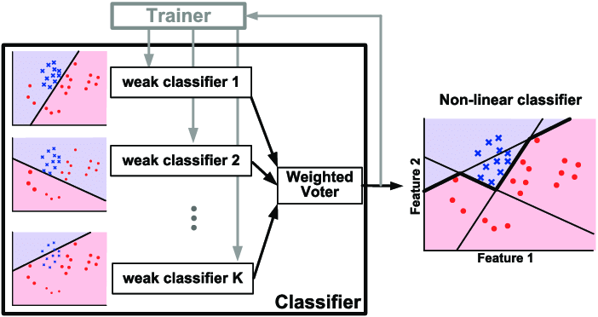
TRAINED MODEL
ADA BOOST
DECISION TREE

Slide 13
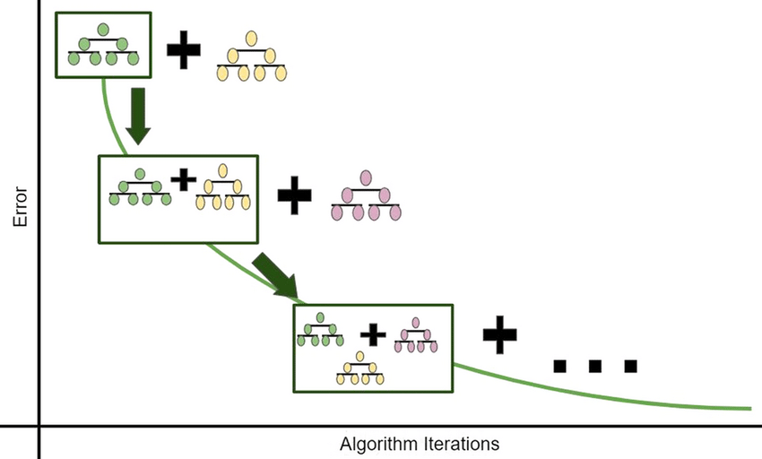
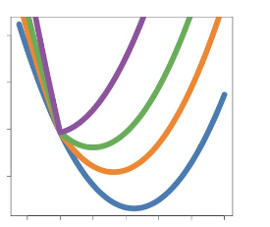
TRAINED MODEL
GRADIENT BOOSTING
DECISION TREE

Slide 14
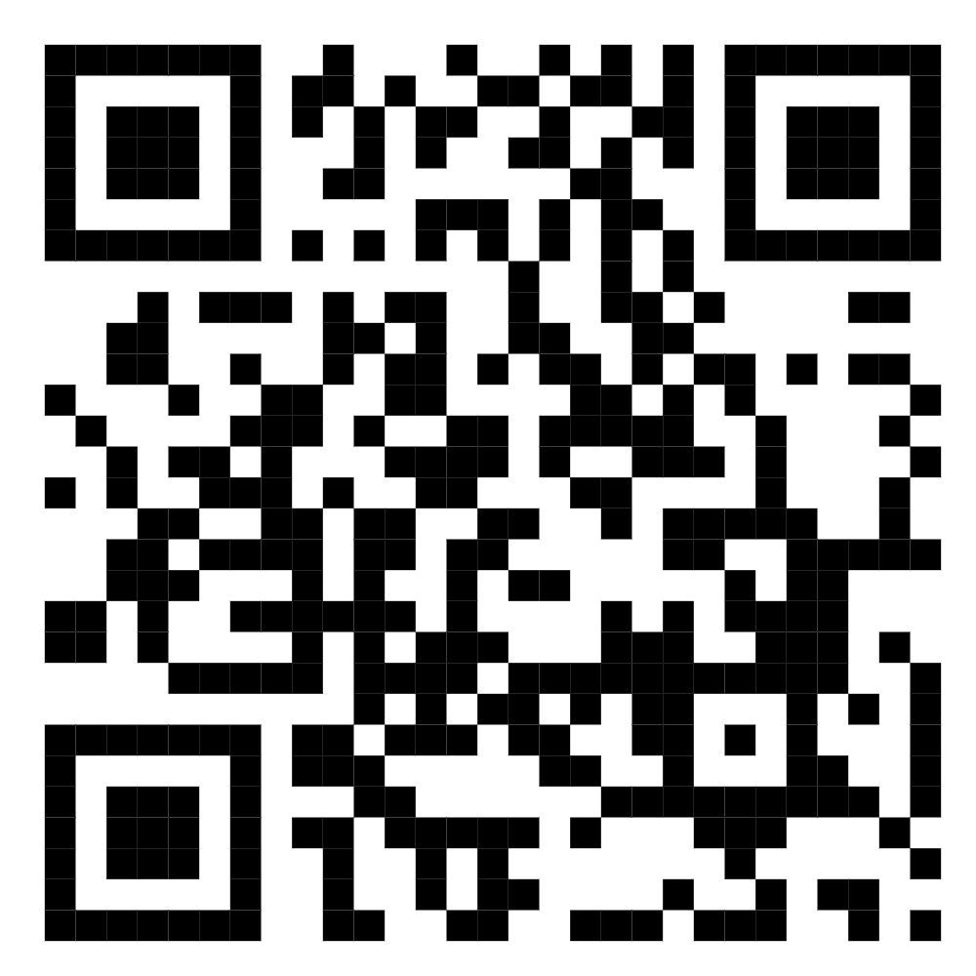
THANK YOU
GITHUB repository

